Slide 1
NASA Applied Sciences Capacity Building Program
Beth Brumbaugh, NASA Langley Research Center
Merna Saad, NASA Langley Research Center
Cindy Schmidt, NASA Ames Research Center
NASA Biodiversity and Ecological
Forecasting Team Meeting
April 22, 2015
College Park, MD

Slide 2
Capacity Building Program Elements
DEVELOP: Dual workforce/local government capacity building using collaborative feasibility projects, internships
Applied Remote SEnsing Training, ARSET: Online and hands on basic/advanced training to build skills
Gulf of Mexico Initiative, GOMI: Building the Gulf coast region’s capacity to meet local needs
SERVIR: Building international capacity with hubs in East Africa, Hindu Kush-Himalaya, Mesoamerica, Southeast Asia

Slide 3
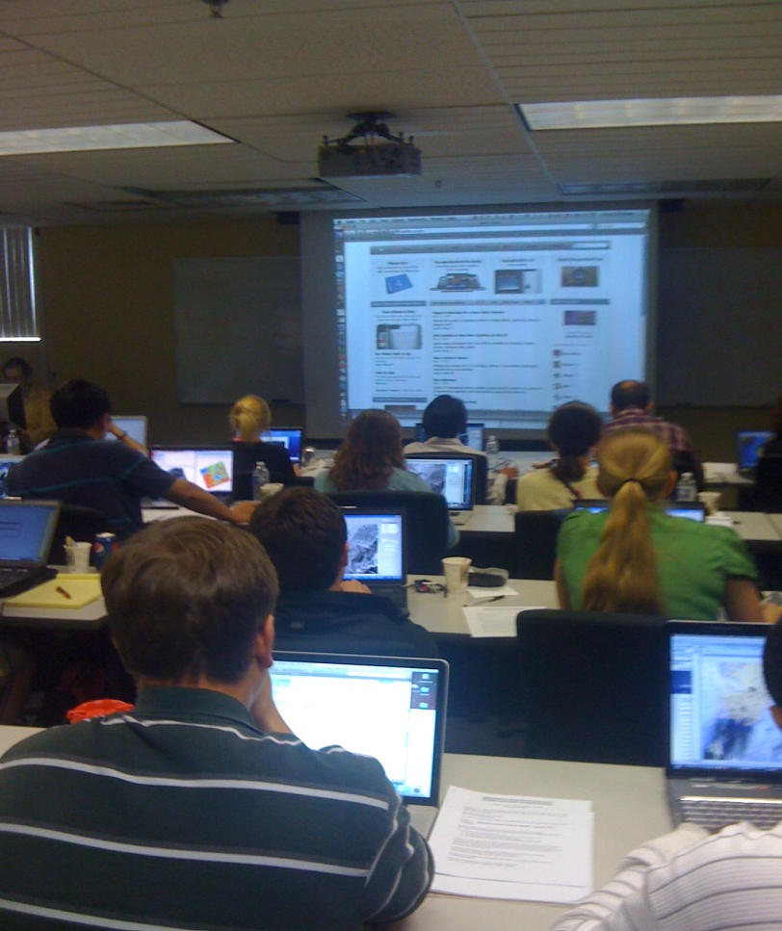
Gradual Learning Approach
Gradual Learning Approach
Basic Courses
Webinars
Hands-on
Assumes no prior knowledge of Remote Sensing
Advanced Courses
Hands-on
Webinar course generally required
Focused on a specific application/problem: for example, products and tools for flooding applications in Colombia
Notes:
Learning how to use NASA data for applications and/or decision-support is a multi step process. Most end-users have a technical background, but not a remote sensing background, we therefore require a basic online or in person course, that teaches remote sensing basics, before students can move into hands on and/or advanced courses. We recently also began advanced online courses, based on end-users requests. In the next slide, I will talk more about the online courses.

Slide 4
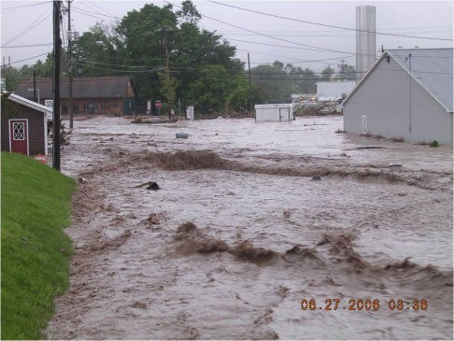
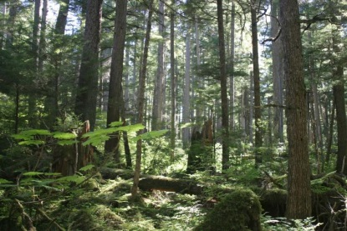
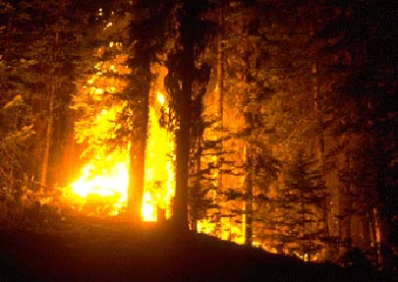
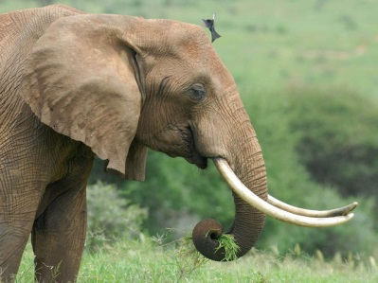
ARSET training topics
Health (Air Quality)
Water Resources & Flood
Land Management
Wildfire**
Conservation**
** Coming this Spring!!

Slide 5
NASA Capacity Building: DEVELOP
With the competitive nature and growing societal role of science and technology in today’s global workplace, DEVELOP is fostering an adept corps of scientists and leaders.

Slide 6
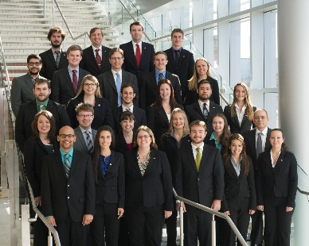
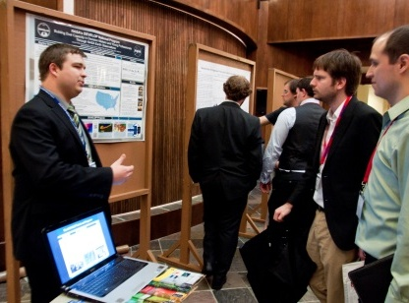
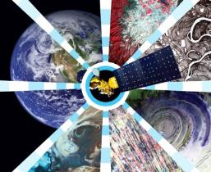
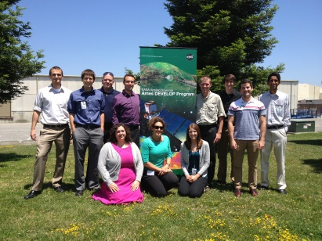
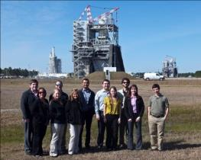
National Aeronautics and Space Administration
DEVELOP National Program
Partnering with DEVELOP:
Program & Projects Overview

Slide 7
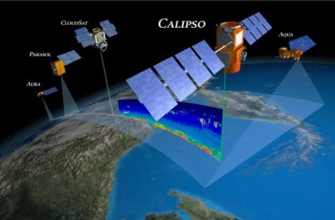
What is DEVELOP?
Measurements
and Predictions
Communities
DEVELOP, part of NASA’s Applied Sciences Program, addresses environmental and public policy issues through interdisciplinary research projects that apply the lens of NASA Earth observations to community concerns around the globe. Bridging the gap between NASA Earth Science and society, DEVELOP builds capacity in both participants and partner organizations to better prepare them to address the challenges that face our society and future generations. With the competitive nature and growing societal role of science and technology in today’s global workplace, DEVELOP is fostering an adept corps of tomorrow’s scientists and leaders.
DEVELOP Website: http://develop.larc.nasa.gov

Slide 8
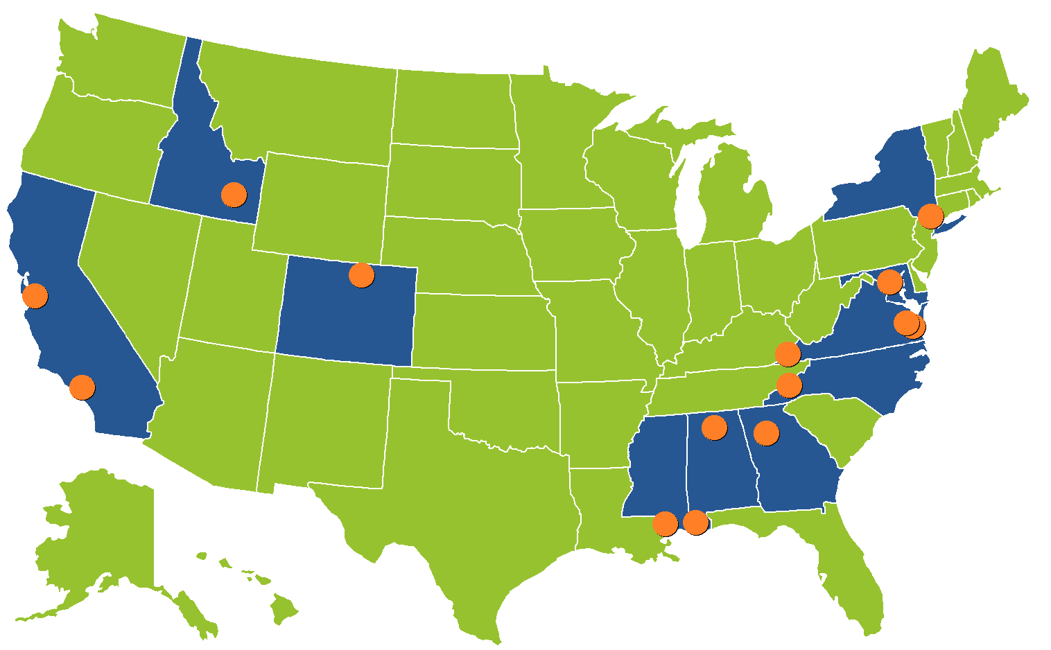
DEVELOP Office Locations
NASA Centers
Ames Research Center – Moffett Field, CA
Goddard Space Flight Center – Greenbelt, MD
Jet Propulsion Laboratory – Pasadena, CA
Langley Research Center – Hampton, VA
Marshall Space Flight Center – Huntsville, AL
Stennis Space Center – Stennis, MS
Regional Locations
BLM at Idaho State University – Pocatello, ID
International Research Institute – Palisades, NY
Mobile County Health Department – Mobile, AL
NOAA National Climatic Data Center – Asheville, NC
Patrick Henry Building – Richmond, VA
University of Georgia – Athens, GA
USGS at Colorado State University – Fort Collins, CO
Wise County Clerk of Court’s Office – Wise, VA

Slide 9
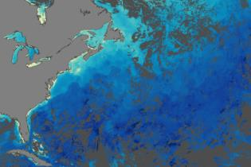
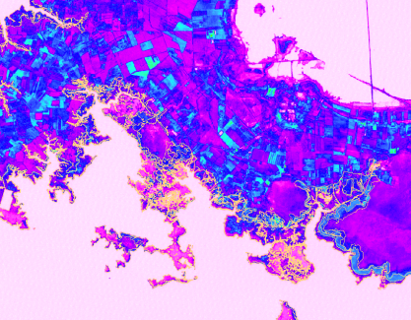
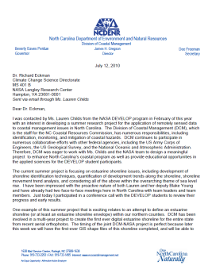
Project Characteristics
Focus on the utilization of NASA Earth observations
Highlight the capabilities of NASA satellite and airborne Earth remote sensing science and technology
Address community concerns relating to environmental issues
Align with at least one of the nine NASA Applied Sciences Program’s Application Areas
Partner with local, state, regional, federal and/or international organizations who can benefit from using NASA Earth observations to enhance decision making
Meet partner needs by providing decision support tools
Research is conducted by teams with diverse backgrounds
Science advisors and mentors from NASA and partner organizations provide guidance
All projects culminate in a set of deliverables (technical report, poster, presentation, video, etc.)
Ten weeks long (spring, summer and fall terms)

Slide 10
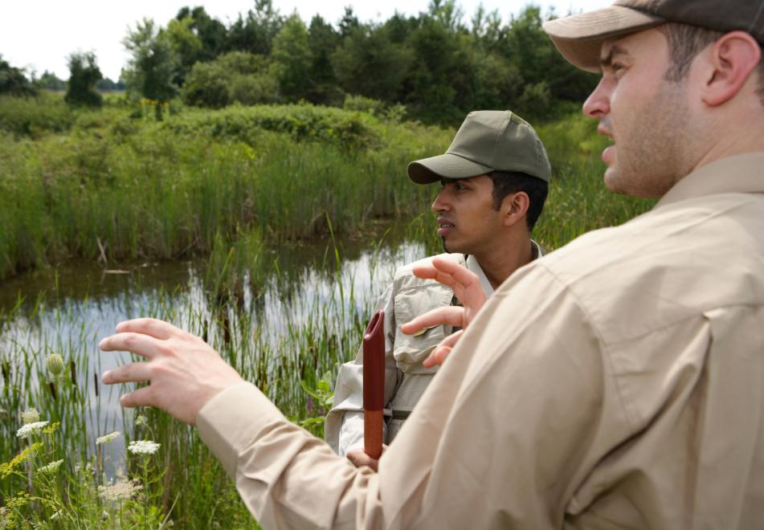
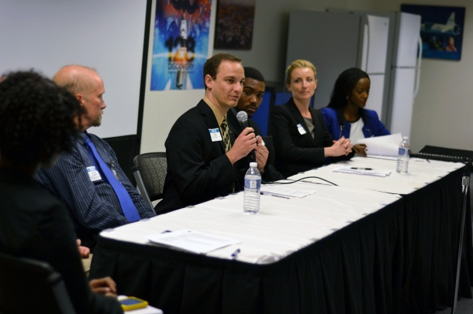
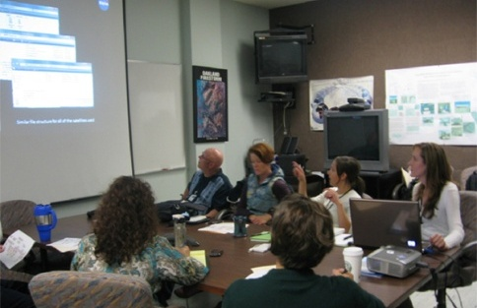
Benefits to Partners & End-Users
Introduction to new methods to augment current practices: Cost-saving & time-saving
Enhanced decision support through use of NASA EOS
Increased exposure to NASA Earth Science technologies and capabilities
Introduction to NASA’s Applied Sciences Program and its contributions to local communities, the country, and the world
Hands-on training with practical applications of remote sensing and NASA Earth science
Improved remote sensing and geographic information science (GIS) capabilities
Interaction with bright and innovative young professionals
Opportunities for networking with the NASA community
Strong recruiting pool of early career professionals with a knowledge of Earth observations and their capabilities

Slide 11
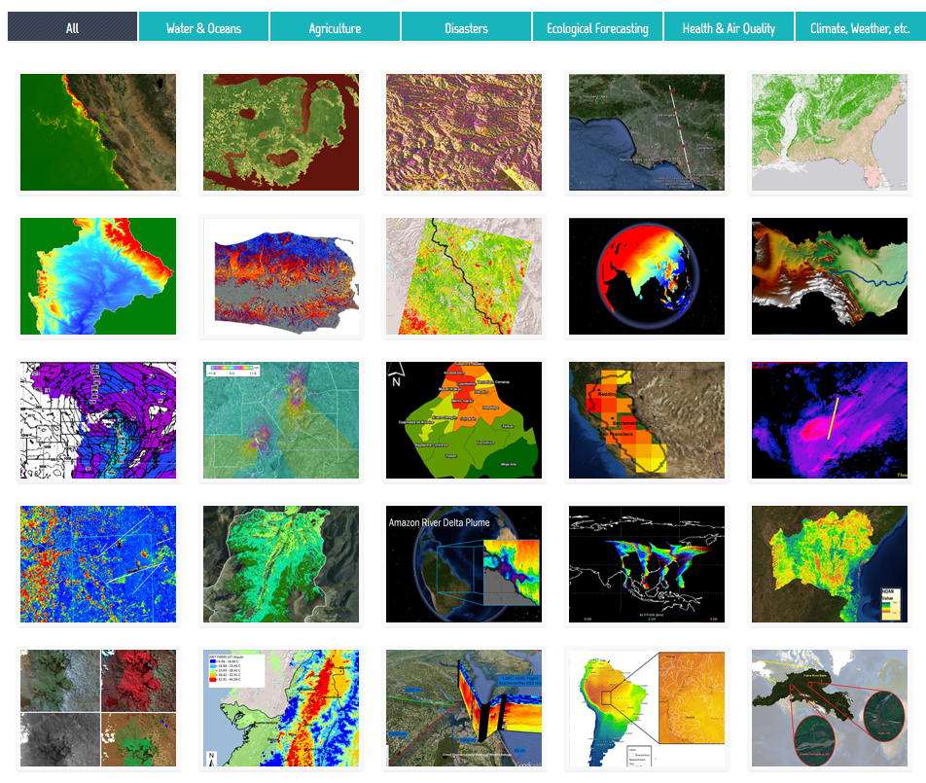
Arizona Ecological Forecasting
Colombia Ecological Forecasting
Previous Project Examples

Slide 12
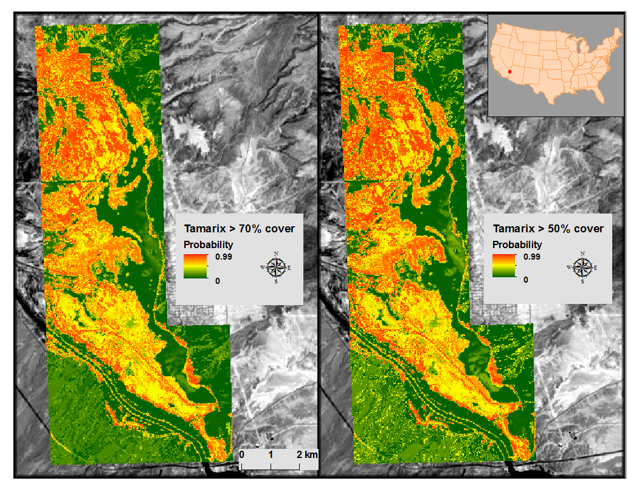
Arizona Ecological Forecasting
Community Concerns
Tamarisk sub-species have invaded riparian zones of the American West
Displace native vegetation that provides bird habitat
Sediment accumulation around tamarisk root systems narrows stream channels and increases flooding potential
Overview
Modeled current extent of tamarisk invasion in Topock Marsh
Map outputs will be incorporated into the DSS being developed for HNWR managers
Predicted Tamarisk Probability
Partners
USGS Fort Collins Science Center
Natural Resource Ecology Laboratory, Colorado State University
USFWS, Havasu National Wildlife Refuge
Notes:
Tamarisk (Tamarix spp.) is a group of invasive terrestrial plant species that displaces native cottonwood and willow in Topock Marsh, habitats that migratory birds are well-adapted to.
Dense tamarisk stands on stream banks accumulate sediment in their extensive roots, narrowing stream channels and increasing flooding potential.
Water and nutrient depletion, coupled with habitat degradation make tamarisk a threat to native fish species such as the humpback chub (Gila cypha). Tamarisk may also increase fire frequency and intensity, as it accumulates significant leaf litter particularly when growing in monoculture stands.
This study mapped tamarisk cover in and around Topock Marsh using field observations, Landsat 8, and species distribution models. Results indicate that nearly half of the study area is currently invaded by tamarisk. These results will be refined during the Spring 2015 DEVELOP term, and will serve as an important component of the decision support system being developed for Havasu NWR managers. This analysis will be enhanced through the use of additional occurrence points collected at the study site. Furthermore, unmanned aerial system data collected by our partners at USGS will be integrated with the Landsat 8 scenes to further refine the models. This may assist in distinguishing native mesquite or additional vegetation types present on the landscape.

Slide 13
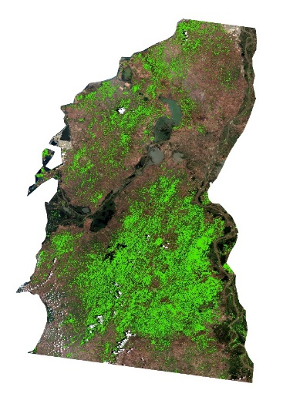
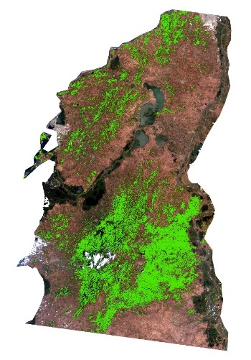
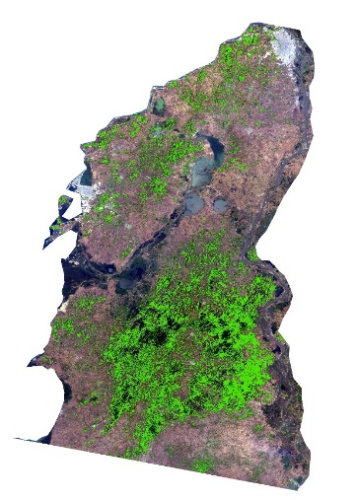
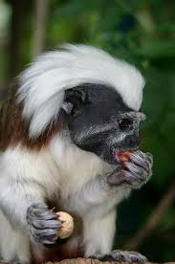
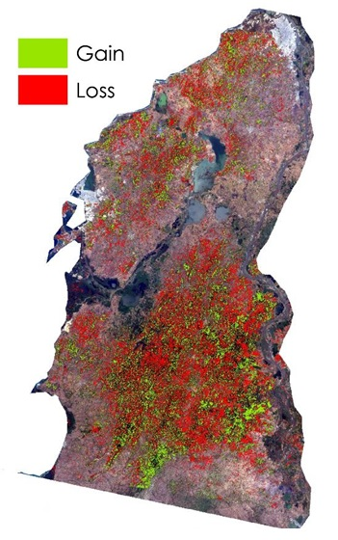
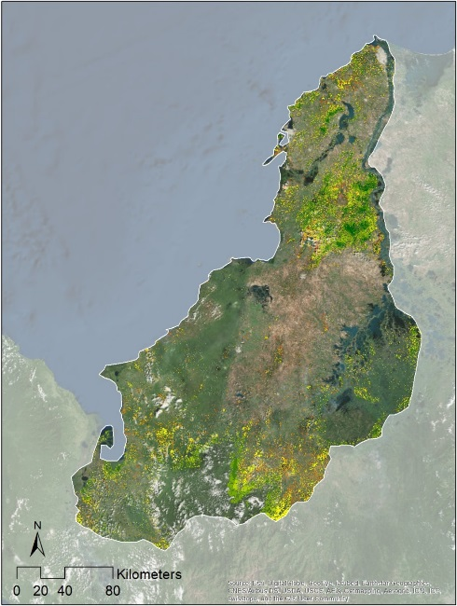
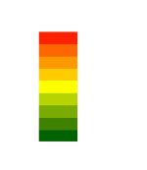
Colombia Ecological Forecasting
Community Concerns
Cotton-top Tamarin species is critically endangered with only 6,000 individuals remaining
Threats include deforestation, biomedical research, and illegal pet trade
Partners
Disney’s Animal Kingdom
Proyecto Tití
Overview
Create a time series of Landsat imagery displaying deforestation within the historic range of Tamarin habitat
Conduct a forest connectivity assessment and identify land tracts suitable for habitat conservation
1991
2002
2014
Landsat 5 TM
Landsat 7 ETM+
Landsat 8 OLI
Suitable Areas for Conservation
Less Suitable
More Suitable
Forest loss of 20 % from 1991 to 2014
Notes:
Departments: Antioquia, Atlántico, Bolívar, Chocó, Córdoba, and Sucre
Advisors: John Schnase, Mark Carroll, & Keith Weber

Slide 14
Partnering w/ DEVELOP
Project Partner (10 weeks)
Project activity takes place at an established DEVELOP node
Partner Provides: Project Idea, Advising
DEVELOP Provides: Participants (pay and limited travel), Project Management
Interested in partnering with DEVELOP?
Express interest to DEVELOP NPO:
Beth Brumbaugh, Elizabeth.J.Brumbaugh@nasa.gov
Merna Saad, Merna.N.Saad@nasa.gov
Lauren Childs-Gleason, Lauren.M.Childs@nasa.gov
Dr. Kenton Ross, Kenton.W.Ross@nasa.gov
Work with DEVELOP to define project topic and scope, and complete the project request form (found under the “Partners” tab on website)
Notes:
Project Partner- We have partnered with the USDA ARS and with the US Forest Service on various projects in the past. For example, the Great Plains drought project and the US plant hardiness zone project both partnered with the USDA ARS, and a Sierra Nevada project is partnered with the Forest Service.
Hosting a Node- We currently have nodes at the USGS NCCSC, where Jeff Morisette is the host and one of the main science advisors and at NOAA’s National Climatic Data Center in Asheville, NC. This summer our newest node will open at the BLM/Idaho State University under the guidance of Keith Weber.

Slide 15
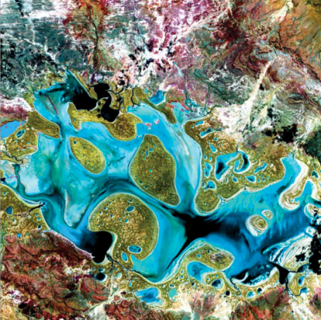
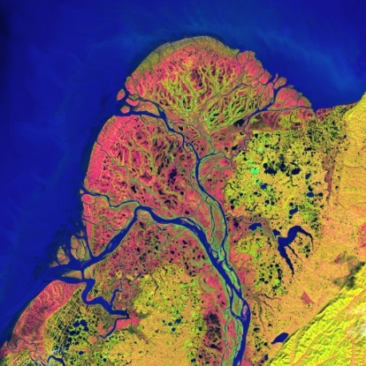
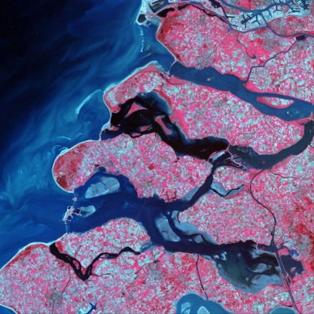
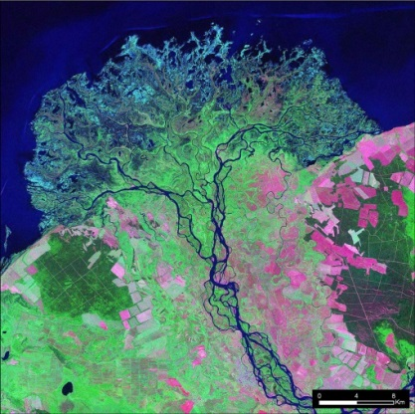
Project Idea & Proposal Timeline
Fall Projects
Collection of ideas & writing of proposals: due mid-April
Fall Term: mid-September to mid-November
Spring Projects
Collection of ideas & writing of proposals: due mid-September
Spring Term: late January to early April
Summer Projects
Collection of ideas & writing of proposals: due early December
Summer Term: early June to early August

Slide 16
Thank You!
Questions?
NASA-DL-DEVELOP@mail.NASA.gov

